Slide 1



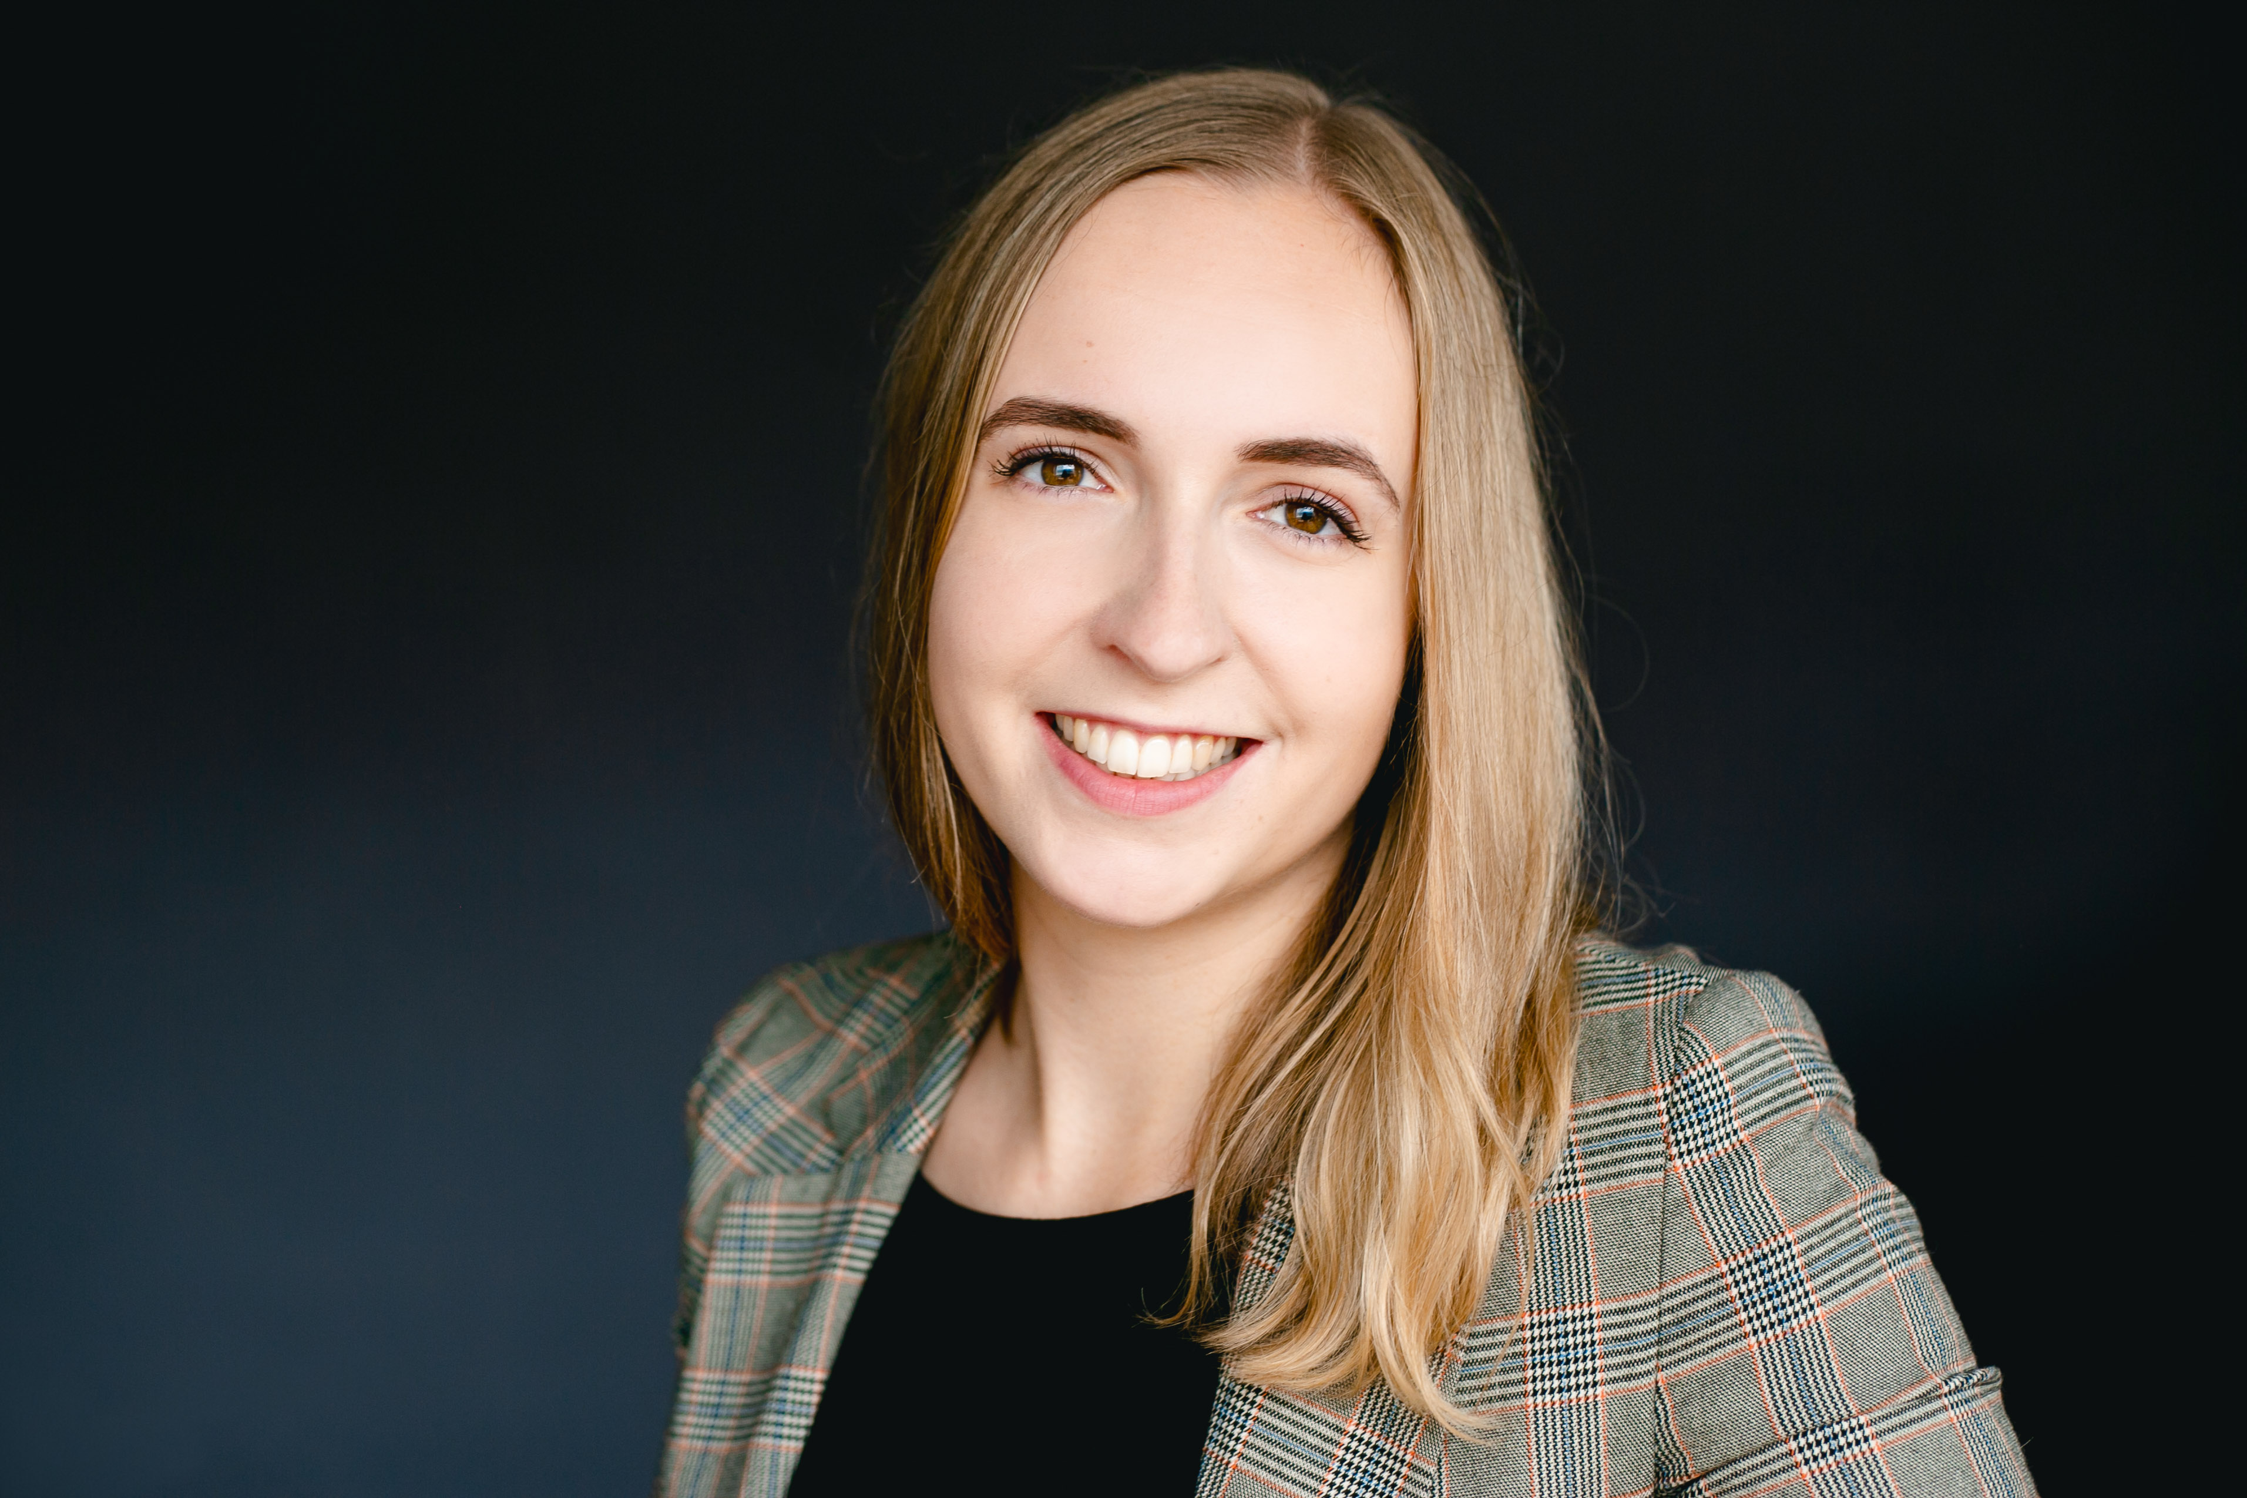
MY PROFILE
CHAT
JOIN A NEW GAME
TOP 10
#1
saskia
223XP
ONGOING GAMES
#2
saskia
223XP
Photo
#3
saskia
223XP
saskia
vs.
jonas
#4
saskia
223XP
#5
saskia
223XP
Photo
#6
saskia
223XP
sassi
vs.
jonas
#7
saskia
223XP
#8
saskia
223XP
Photo
#9
saskia
223XP
saskia
vs.
jonas
#10
saskia
223XP

Slide 2
MY PROFILE
CHAT
You and Saskia are friends.
UNFRIEND
BLOCK
ACHIEVEMENTS
sassi
A
A
A
XP:
227
Rank:
#14
A
A
A
GAME HISTORY
saskia
WIN
11 : 5
03.05.2023
17:43h
+ 78 XP
sassi
LOSS
3 : 11
03.05.2023
16:47h
+ 0 XP
saskia
LOSS
10 : 11
03.05.2023
16:41h
+ 0 XP
sassi
WIN
11 : 10
02.05.2023
18:45h
+ 98 XP

Slide 3

MY PROFILE
CHAT
ACHIEVEMENTS
saskia
A
A
A
XP:
227
Rank:
#14
A
A
A
GAME HISTORY
saskia
WIN
11 : 5
03.05.2023
17:43h
+ 78 XP
sassi
LOSS
3 : 11
03.05.2023
16:47h
+ 0 XP
saskia
LOSS
10 : 11
03.05.2023
16:41h
+ 0 XP
sassi
WIN
11 : 10
02.05.2023
18:45h
+ 98 XP

Slide 4


MY PROFILE
CHAT
ACCOUNT SETTINGS
Nickname:
saskia
Two-Factor-Authentication:
Change Profile Picture
GAME SETTINGS
Upload new picture
Reset to 42 intra picture
Game Design B
Game Design C
SAVE CHANGES
CANCEL

Slide 5
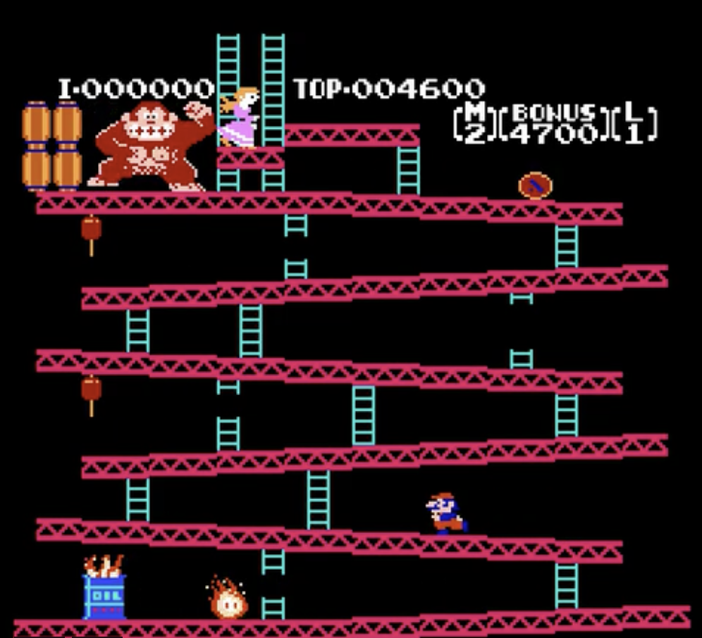
MY PROFILE
CHAT
WAITING FOR AN OPPONENT …
CANCEL

Slide 6
MY PROFILE
CHAT
sassi
saskia
5
O
3
END GAME

Slide 7

MY PROFILE
CHAT
sassi
saskia
11
3
YOU LOST
EXIT

Slide 8

MY PROFILE
CHAT
sassi
saskia
11
3
YOU WON
EXIT

Slide 9
MY PROFILE
CHAT
>
FRIENDS
DonkeyKongUltras
INVITE
LEAVE
OWNER
…
…
saskia
saskia
jonas: I’ve got a great idea… let’s do a tournament
…
jonas
florian: Great idea! When do you have time?
ADMINS
…
triinu: I first want to finish my other game
triinu
…
me: I would be down too!
jonas
…
florian
…
florian
…
ferenc
OTHERS
>
OTHER USERS
me
…
CHANNELS
triinu
>
…
ferenc
DonkeyKongUltras
…
otherDude
DonkeyKongUltras
> I would be down too!
SEND
Mario-Fans
JOIN
Pro Pongers
JOIN

Slide 10





















MY PROFILE
CHAT
>
FRIENDS
DonkeyKongUltras
INVITE
LEAVE
OWNER
Username
me
>
OTHER USERS
jonas: I’ve got a great idea… let’s do a tournament
florian: Great idea! When do you have time?
…
f
ADMINS
saskia
triinu: I first want to finish my other game
Send friend request
…
florian
jonas
…
me: I would be down too!
jonas
Send game invite
ferenc
…
florian
…
triinu
…
Block User
OTHERS
florian
…
…
saskia
ferenc
Send friend request
…
CHANNELS
triinu
>
Send game invite
…
ferenc
DonkeyKongUltras
Set as Admin
…
otherDude
DonkeyKongUltras
Mute
> I would be down too!
SEND
Kick
Mario-Fans
JOIN
Ban
Pro Pongers
JOIN
Block User

Slide 11
MY PROFILE
CHAT
>
FRIENDS
DonkeyKongUltras
INVITE
LEAVE
OWNER
>
OTHER USERS
me
jonas: I’ve got a great idea… let’s do a tournament
- CHANNEL SETTINGS -
florian: Great idea! When do you have time?
…
ADMINS
saskia
triinu: I first want to finish my other game
…
Channel Type:
>
jonas
Password protected
…
me: I would be down too!
jonas
…
florian
…
triinu
Password:
********
…
OTHERS
florian
New password:
…
…
saskia
ferenc
SAVE
CANCEL
…
CHANNELS
triinu
>
…
ferenc
DonkeyKongUltras
…
otherDude
DonkeyKongUltras
> I would be down too!
SEND
Mario-Fans
JOIN
Pro Pongers
JOIN

Slide 12
MY PROFILE
CHAT
>
FRIENDS
saskia
>
OTHER USERS
saskia: how are you doin?
me: Great, and you?
…
saskia
saskia has send you a game invite!
ACCEPT
…
jonas
saskia has sent you a friend request!
ACCEPT
saskia invited you to the channel “DonkeyKongUltras“!
…
JOIN
triinu
…
florian
…
ferenc
>
CHANNELS
DonkeyKongUltras
DonkeyKongUltras
> Wanna play a game?
SEND
Mario-Fans
JOIN
Pro Pongers
JOIN

Slide 13
MY PROFILE
CHAT
Open: - example for what happens when clicking invite
Example for what happens when clicking dots -> all action items
Example for what happens when you have an unread message
Example for what happens when you get a game invite
Dots also in friends column
Unfriend icon
>
FRIENDS
saskia
>
OTHER USERS
saskia: how are you doin?
- CHANNEL PASSWORD -
me: Great, and you?
…
saskia
saskia has send you a game invite!
ACCEPT
The Channel “DonkeyKongUltras” is password-protected. Please enter the password:
…
jonas
saskia invited you to the channel “DonkeyKongUltras“!
JOIN
…
triinu
Password:
…
********
florian
…
JOIN
CANCEL
ferenc
>
CHANNELS
DonkeyKongUltras
DonkeyKongUltras
> Wanna play a game?
SEND
Mario-Fans
JOIN
Pro Pongers
JOIN

Slide 14
MY PROFILE
CHAT
#1 - #10
#1
saskia
223XP
14 WINS
1 LOSSES
SEND GAME INVITE
#2
saskia
223XP
14 WINS
1 LOSSES
SEND GAME INVITE
#3
saskia
223XP
14 WINS
1 LOSSES
SEND GAME INVITE
#4
saskia
223XP
14 WINS
1 LOSSES
SEND GAME INVITE
#5
saskia
223XP
14 WINS
1 LOSSES
SEND GAME INVITE
#6
saskia
223XP
14 WINS
1 LOSSES
SEND GAME INVITE
#7
saskia
223XP
14 WINS
1 LOSSES
SEND GAME INVITE
#8
saskia
223XP
14 WINS
1 LOSSES
SEND GAME INVITE
#9
saskia
223XP
14 WINS
1 LOSSES
SEND GAME INVITE
#10
saskia
223XP
14 WINS
1 LOSSES
SEND GAME INVITE
< PREVIOUS
NEXT >

Slide 15
LOGIN

